Slide 1
PA 604
THEORY
Professor Burrel Vann Jr

Slide 2
OBSERVATION
DIRECT:
YOUR OBSERVATIONS OF SOCIETY
INDIRECT:
OTHERS' OBSERVATIONS OF SOCIETY
EXPLANATION
REASONS (A THEORY) FOR THE PATTERNS YOU SEE IN THE OBSERVATIONS
Notes:
An interesting thing about some relationships is that some outcomes can be predicted by completely unrelated phenomena. For example, some theaters can predict presidential winners based on the popcorn they give out, or farmers choice in grain can predict the same… but these are oddities… we know that patterns exist in nature, but the connections between two patterns (or the ability for one to predict the other) may be mere flukes, or chance occurrences… This is why we need good, logical explanations for the patterns we find. This is through theory.
If we can’t explain a finding, then people will think it’s a fluke.
If we make sense of it, why something – especially bad – happens, then we can understand HOW to fix it
If we understand the theory, then we know where’s a good place to look for discoveries (if we had to find our keys, theory – our memory/understanding of where we last had the keys – will direct us where best to look).

Slide 3
Theory (based on prior research) is an explanation for the relationships between variables and patterns we observe

Slide 4

MODELS OF THEORY BUILDING
DEDUCTIVE THEORY
Top-down (literature) theory construction
INDUCTIVE THEORY
Bottom-up (data-driven) theory construction

Slide 5
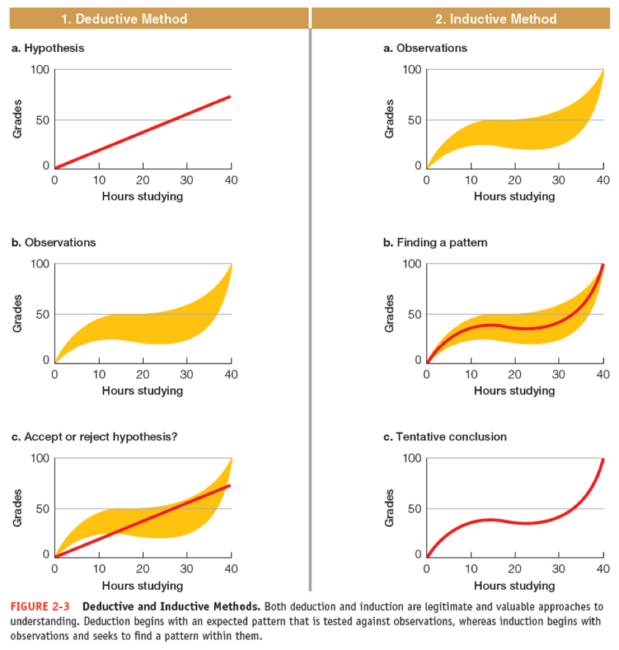
MODELS OF THEORY BUILDING
DEDUCTIVE
develop research question
read research on relationship b/w variables
develop theory & hypotheses based on research
collect data
analyze data to test theory
INDUCTIVE
develop research question
read research on relationship b/w variables
collect data
analyze data
develop theory to explain data

Slide 6
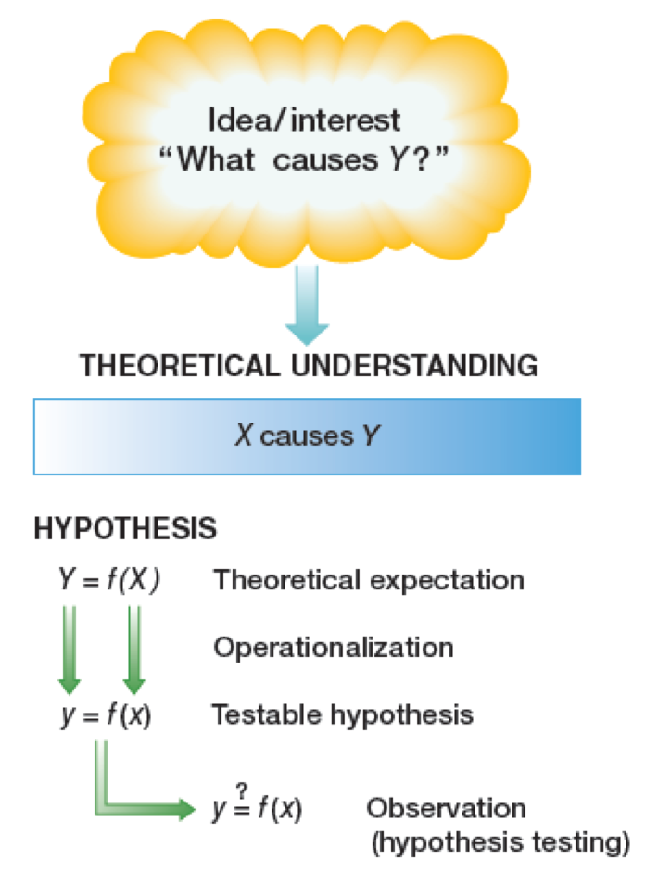
TRADITIONAL MODEL OF SCIENCE
Deductive Theory Construction
Notes:
A hypothesis is something derived from theory. It is a specified, testable expectation about empirical reality. If the theory is correct, then this specific relationship should hold in the real world. . Theory about the causes of delinquency… that delinquency is related to social class... (that variation in social class is related to variation in delinquency)... A hypothesis could be something like: social class is inversely related to delinquency (as class goes up, delinquency goes down).
Operationalization differs for every variable that exists. Different ways of measuring the same thing, so your operational definition is important… why you chose to measure that way.
Observation is making the measurements
Good hypotheses are disconfirmable.

